Slide 1
DECENTRALISED SYSTEM OF BANKING FOR FUND RAISING ON ETHEREUM USING BLOCKCHAIN
NAVANIP PRIYA B

Slide 2
OBJECTIVE
To have no control of their raised funds once the contribution have been made. The contributors and the donators have no knowledge of where their donated money is being used at or for.
To make proper use of fund, the person who started the funding campaign may use the funds for his/her personal needs thereby dissolving the essence of whole fund raising idea.
To build a fundraising website accessible to everyone whose working will be transparent.
To reduce of bank money frauds, the system should be made decentralised and to set up security
measures using Keccak256 cryptographic hashing.
To create a smart contract that will also feature a spending request creation for efficient use of project funds.
To construct the voting process and set it up such that only contributors who have invested in that particular project have the ability to approve or reject the project managers’ requests for expenditures.

Slide 3
ABSTRACT
Our decentralised application on the Ethereum Network uses blockchain technology, and its major goal is to increase transparency. Blockchain is used to preserve records of user contributions, which will decentralise banking for fund-raising and prevent bank money fraud. All banking transactions will be handled by a single central smart contract. Anyone can use the contract to launch a campaign to raise money for their firm. The contributors have the option to send funds to the smart contract we'll be deploying The campaign creator or manager will then ask the smart contract to generate a request to transfer the necessary amounts to the chosen vendor. Each contributor accepts the created request and any resulting consensus. The manager of the raised request can finalize the request and the transaction takes place from the contract to the vendors if the number of approvals is greater than half of the total contributors or donators. This will lessen fraud and contribute to the delivery of a reliable banking system. There will be a check for each request for the transfer of money from a smart contract to the vendors, and the funds cannot be utilized for one's own requirements.

Slide 4
INTRODUCTION
In this part, the term "blockchain" is defined and the idea of a "blockchain framework" is introduced. Also, it provides a summary of the project's deliverables as described in the block chain framework.
OVERVIEW
Problems with today's fundraising applications like KickStarter and Ketto.
The contributors and the donators have no knowledge of where their donated money is being used at or for. They have no control of their raised funds once the contribution have been made. According to a research, 9% of the projects on KickStarter fail to deliver the product. The person who started the funding campaign may use the funds for his/her personal needs thereby dissolving the essence of whole fund raising idea. These are the cases of bank money frauds and to reduce it, the system should be made decentralised. Blockchain with Ethereum would not only help in the economy of the nation but also would reduce the flow of money in some hands only.

Slide 5
LITERATURE REVIEW
Author | Title | Propose | Drawback
Sakho et al., 2019 | Improving Banking Transactions Using Blockchain Technology | This research demonstrates how they developed a storage and bank exchange platform based on a private and confidential blockchain . | The transaction information was reprsented in textual and tabular forms. Such forms make understanding cryptocurrency transaction mechanisms difficult for novice users (NUsers). They are also insufficiently informative for experienced users (EUsers) to recognize advanced transaction information.
Arantes et al., 2018 | Improving Lending , Monitoring and Evaluating the process | This paper proposes an improved system for funding , monitoring and analyzing development projects at a Brazilian development bank using blockchain technology . | There are problems of reaching a fast consensus in a large-scale blockchain network, consuming excessive energy for calculation, and storing the entire blockchain for verification.

Slide 6
Author | Title | Propose | Drawback
Z. Zhong et al., 2020 | A visual explorer of blockchain-based cryptocurrency transaction data | They created a series of appreciating visualization designs, such as paper ledger-inspired block and blockchain visualizations and ancient copper coin-inspired transaction visualizations, to help users understand cryptocurrency transaction mechanisms and recognize advanced transaction information. | The promises given to donors are frequently not guaranteed by crowd funding techniques, which can be unjust to the contributors, discourage them from participating in the effort, and complicate project management.
T.-S. Kang et al., 2021 | Blockchain-based lightweight transaction process modeling and development | They proposed a lightweight transaction-based blockchain application model optimized for areas with weak computing and network resources such as vending machines and ATMs | In traditional crowd funding, the whole sum of money is in the hands of the management, and the amount utilised by the manager is made without regard for the opinions of investors. As a result, there is no guarantee of security in this circumstance.

Slide 7
Author | Title | Propose | Drawback
P. Deshmukh et al., 2020 | Decentralised freelancing using ethereum blockchain | The proposed system will have peer to peer transaction using cryptocurrency and peer to peer reviews on the distributed ledger of Ethereum. | Security and privacy measures are not mentioned in this proposed system.

Slide 8
PROPOSED SYSTEM
This study's design has a solid smart contract that will support with campaign creation and the assignment of metrics like name, description, and minimum donation.
3.2.1 Promote Campaign
The deployment of the campaign instance to the Goreli network is done in the campaign factory contract.
3.2.2 Discover Projects
The first page that loads when the web application is opened is the campaign page. The campaigns that are now running are shown here, and a new campaign can also be started.
3.2.3 Create campaign
Before a campaign is given a special blockchain address, a new user adding a campaign is asked for a minimum contribution amount. This URL is used for communication between the campaign and the react application. Moreover, msg.sender keeps track of any nodes' addresses that invoke clever agreements.

Slide 9
3.2.4 Add details
The campaign manager's address, the minimum contribution, the number of requests the manager has submitted, the number of approvers, and the campaign balance are all listed on this page, which can be accessed by clicking the See Campaign button on the main website. Investments can be voted on by campaign donors.
3.2.5 Back a Project
The contributors have the option to back funds to the smart contract we'll be deploying
3.2.6 Add Requests
The campaign creator or manager will then ask the smart contract to generate a request to transfer the necessary amounts to the chosen vendor. . Each contributor accepts the created request and any resulting consensus.

Slide 10
3.2.7 Approve Request
The management of the raised request can finalise the request and the transaction takes place from the contract to the vendors if the number of approvals is greater than 50% of the total contributors or donators.
3.2.8 Send requests
The contributors have the option to send funds to the smart contract we'll be deploying.
3.2.9 Send Rewards
This will lessen fraud and contribute to the delivery of a reliable banking system. There will be a check for each request to move money from a smart contract to a vendor, and the money cannot be spent.

Slide 11
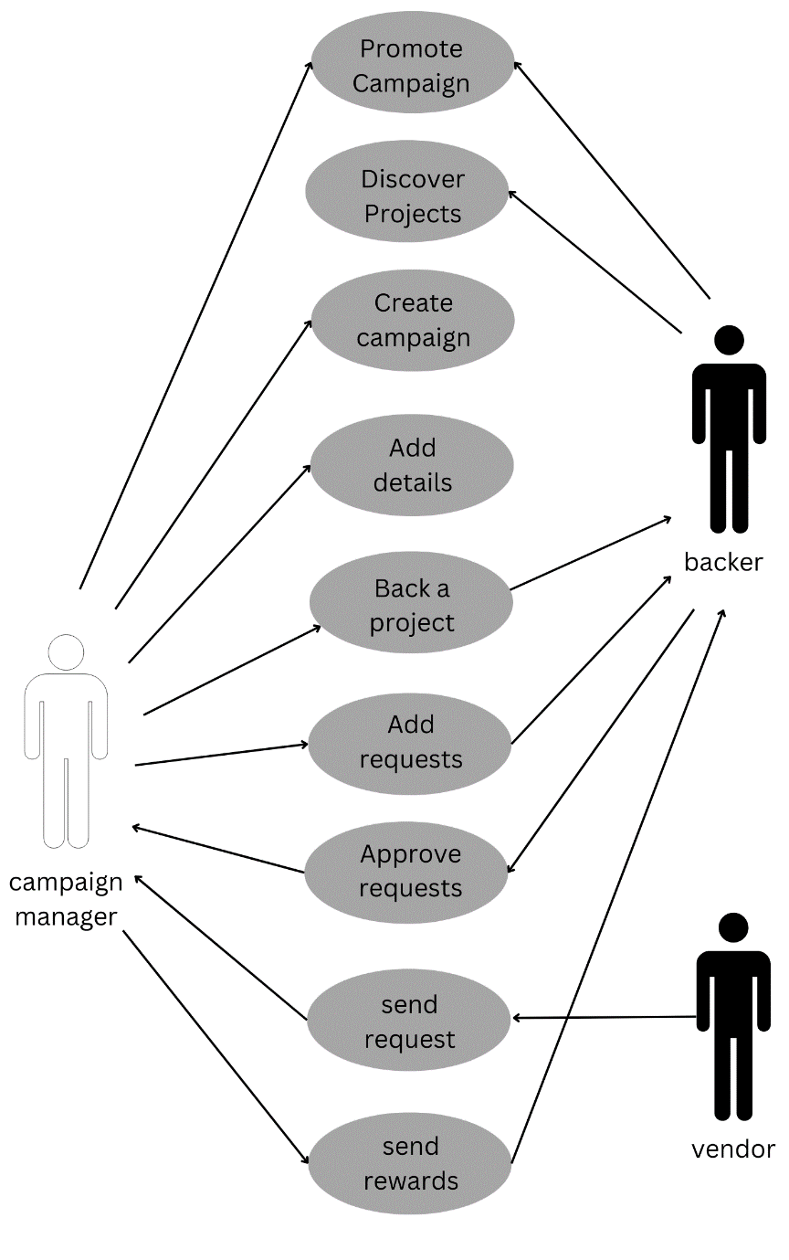
Fig 1. System Design of Proposed System

Slide 12
ADVANTAGES OF PROPOSED SYSTEM
Banks can benefit from blockchain with the use of digital currencies.
They are now able to accept digital currency to complete a variety of transactions.
With cryptocurrency, banks will be able to more easily clear and settle financial trades faster and more securely.

Slide 13
SYSTEM REQUIREMENT
HARDWARE REQUIREMENT
Processor: Dual Core
RAM: 4GB
Hard Disk: 500 GB
Operating System : Mac, Windows, and Linux operating systems
SOFTWARE REQUIREMENT
MetaMask
Node Package Manager
Visual Studio Code
Remix IDE

Slide 14
SYSTEM IMPLEMENTATION
1. Campaign creation
2. Spending Request Module
3. Voting System Module
4. Keccak256 cryptographic hash

Slide 15
1. Campaign Creation
The Campaign manager creates a new project first by providing the campaign name, decline, and minimal contribution. Then, contributors can browse all of the active campaign on the crowd funding platform and choose any campaign to support for any particular campaign. The contributor must contribute at least the minimum amount that the project manager specified when the campaign was founded in order to be recognized as contributors. And the campaign managers can use the raised money now that it has been added to their digital wallet.
2. Spending Request Module
If a campaign manager wishes to use funds provided by contributors at this time, they must initate a spending request that specifies how the raised funds will be spend, how much money will be used overall, and the address of the vendor who will provide the needed materials.

Slide 16
3. Voting System Module
Only contributors who have funded in that particular campaign may approve or disapprove the campaign manager’s requests for expenditures since the voting process is set up in that manner. The voting system also makes sure that a contributor cannot vote for the same expenditure request more than once. Therefore, the raised amount is paid only to the vendor so that the user can deliver the utilities requested by the campaign manager if the expenditure request is approved by 50% of the campaign’s contributors.

Slide 17
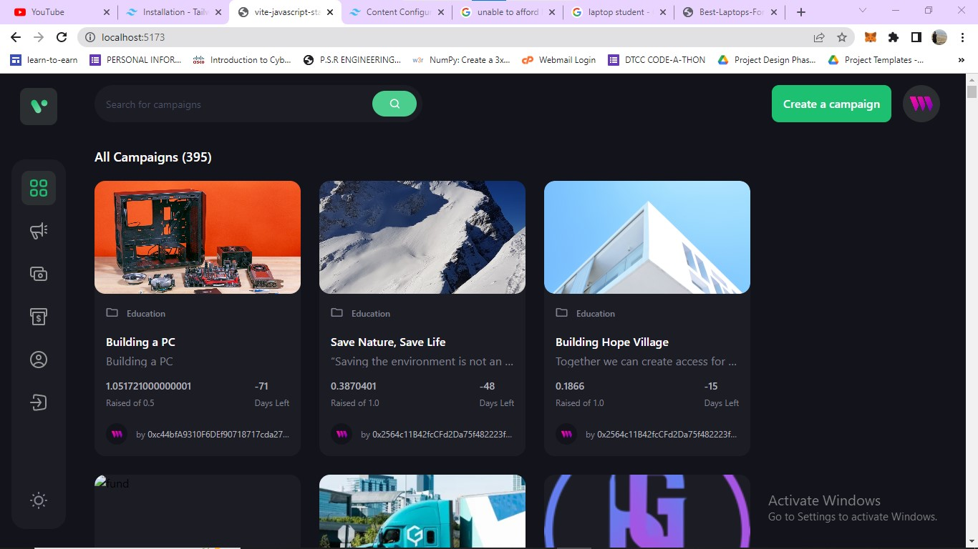
RESULT AND DISCUSSIONS
Fig 6.1 List of available campaigns

Slide 18
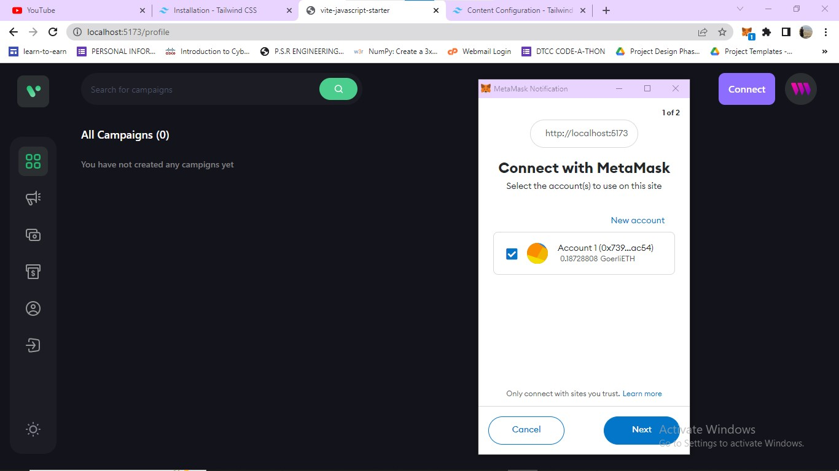
Fig 6.2 MetaMask

Slide 19
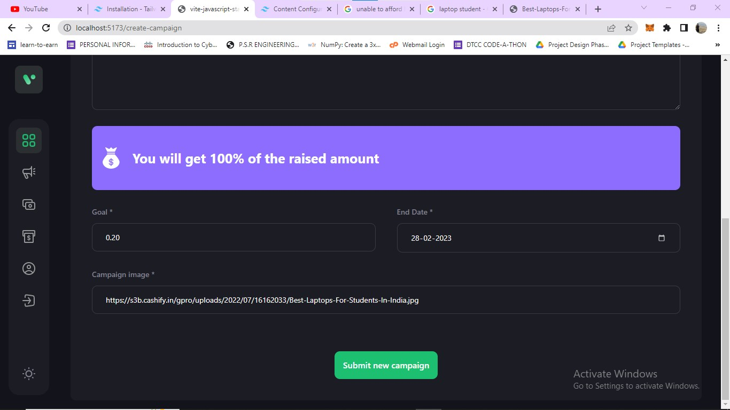
Fig 6.3 Creating a new Campaign

Slide 20
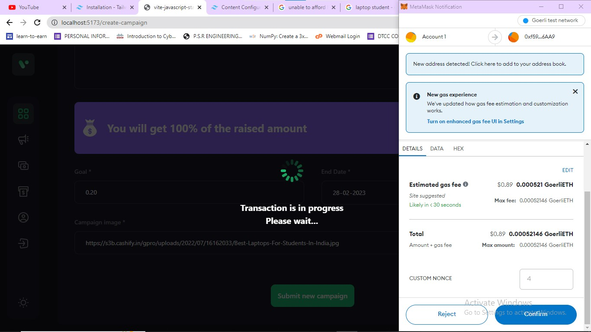
Fig 6.4 Final MetaMask confirmation for creating a new campaign as some Gas is used and it is a transaction

Slide 21
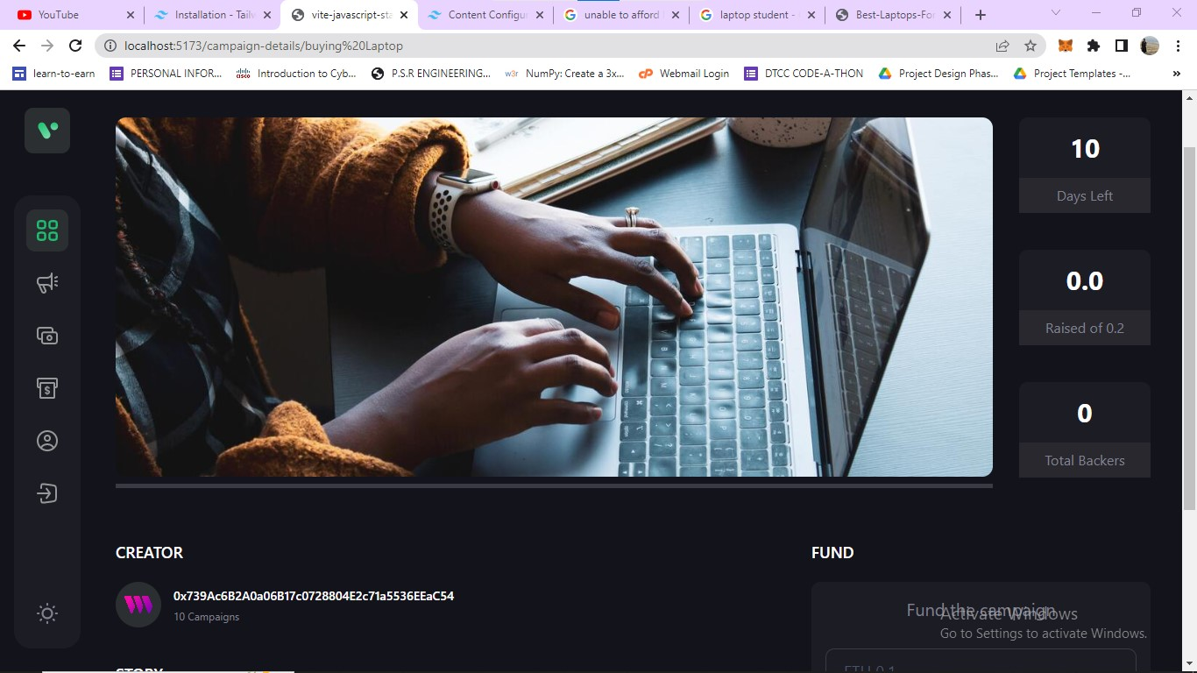
Fig 6.5 New Campaign created

Slide 22
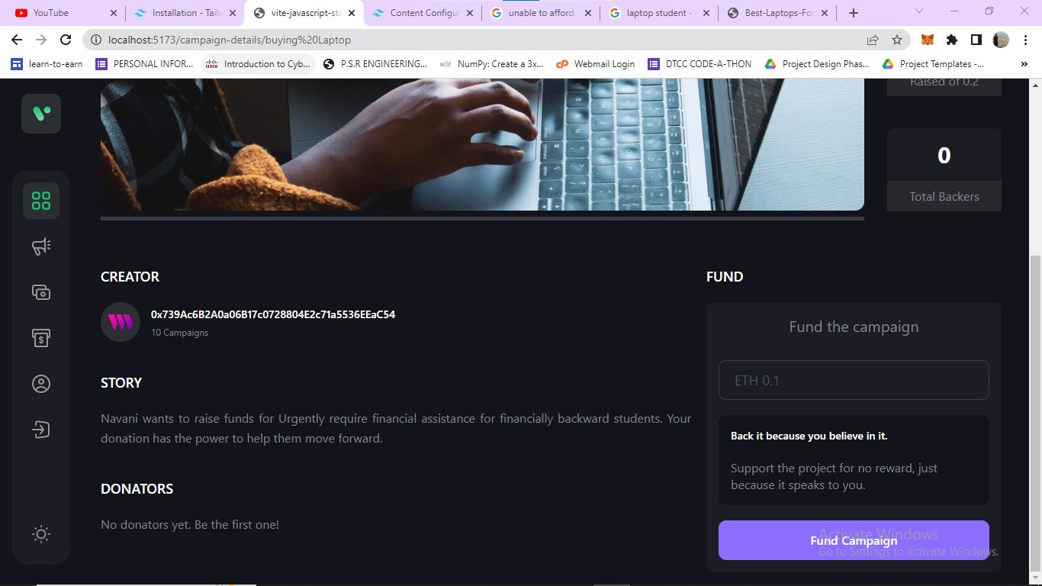
Fig 6.6 The campaign that we just created

Slide 23
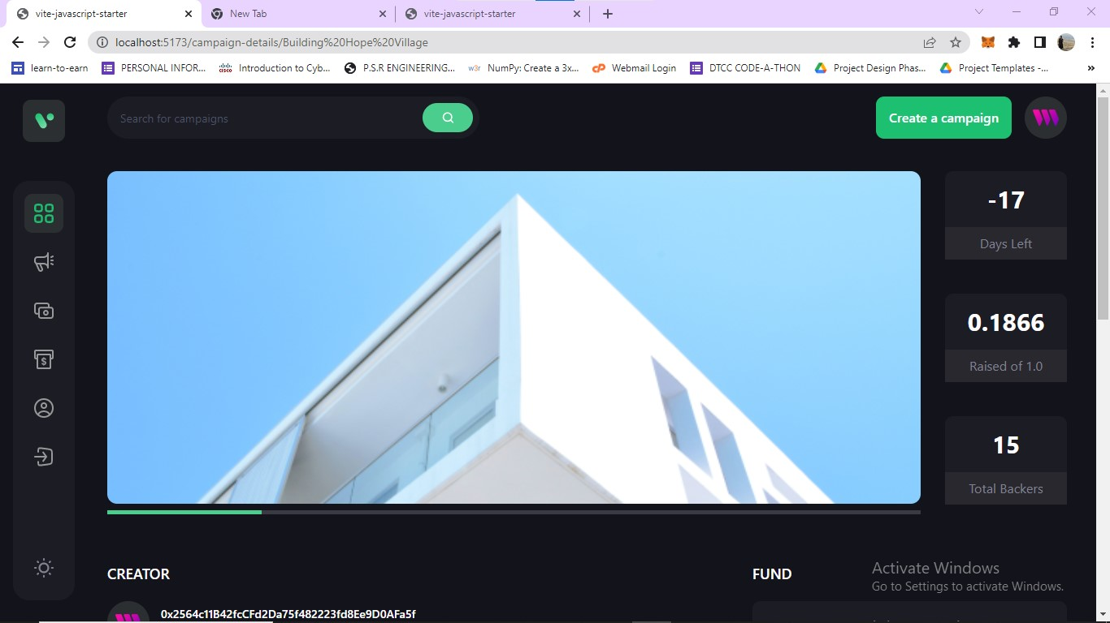
Fig 6.7 Showing a pre-defined campaign

Slide 24
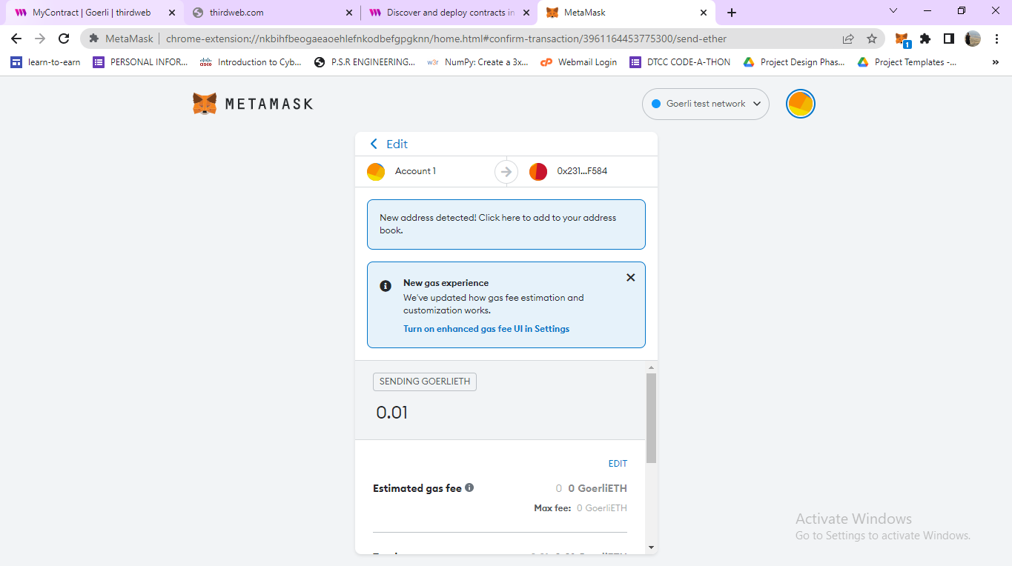
Fig 6.8 Contributing to that particular campaign (0.87 ether)

Slide 25
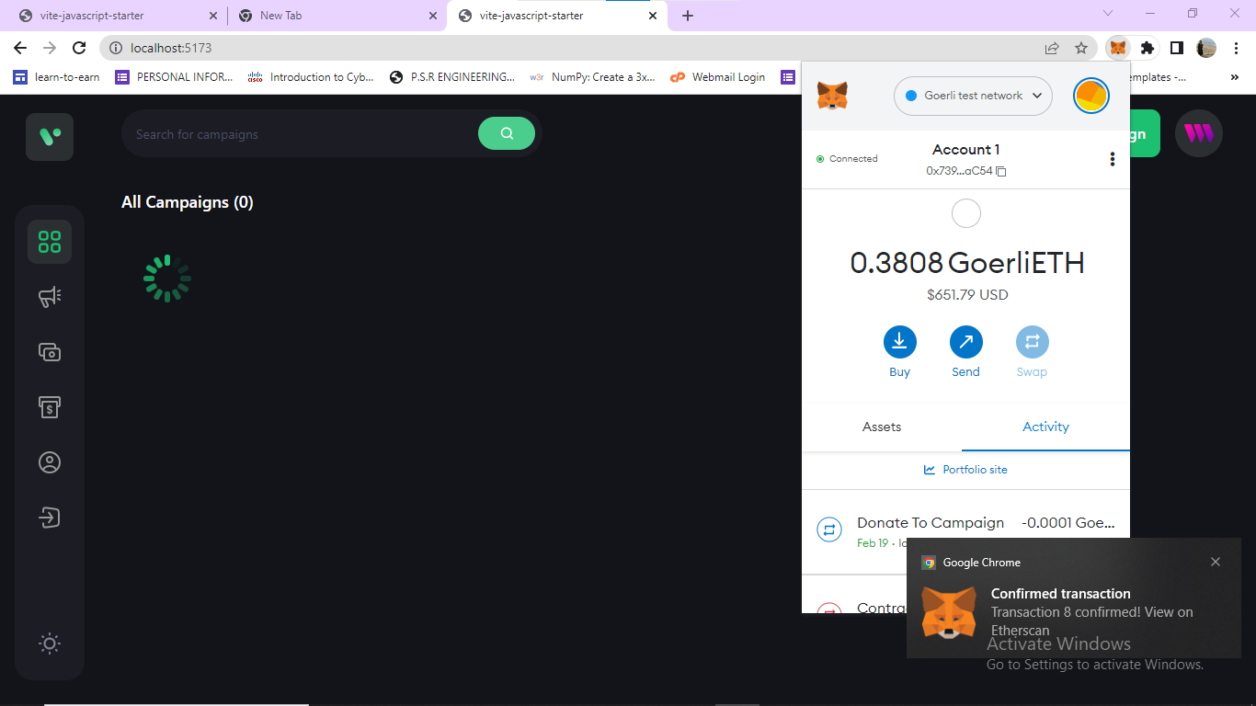
Fig 6.9 Contributing to that particular campaign (0.0001 ether)

Slide 26
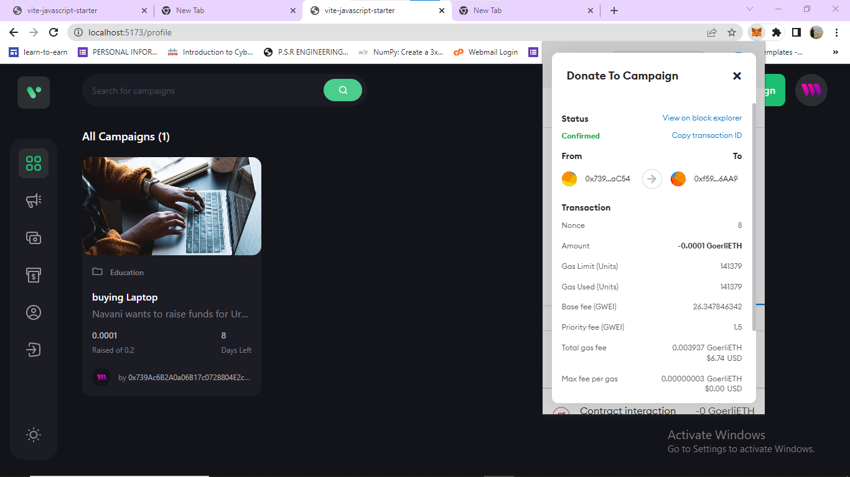
Fig 6.10 Campaign Balance goes up by 0 ether, reached 0.0001 ether.

Slide 27
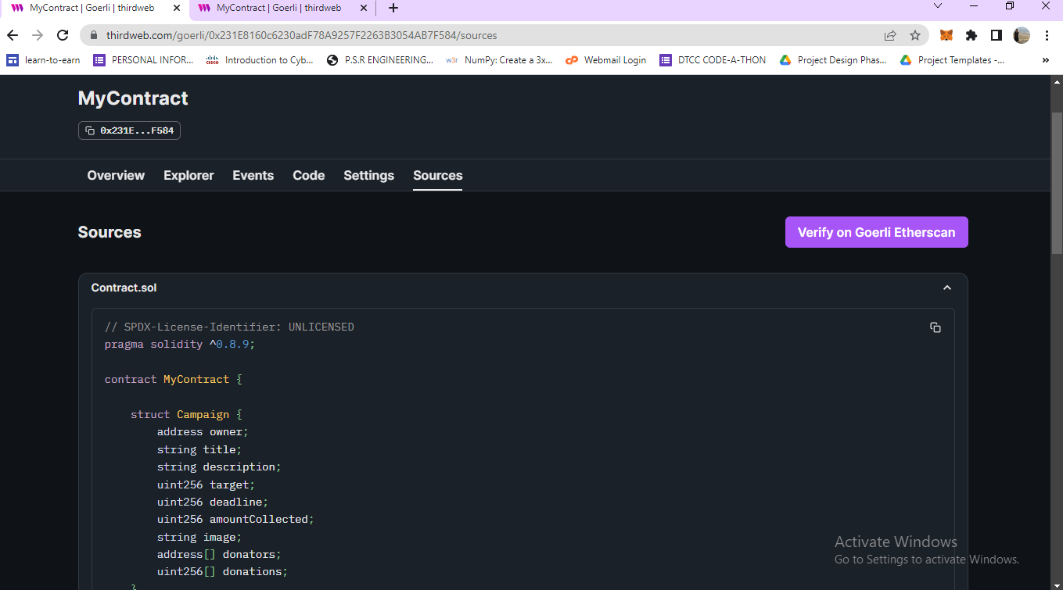
Fig 6.11 Deployed Contracts

Slide 28
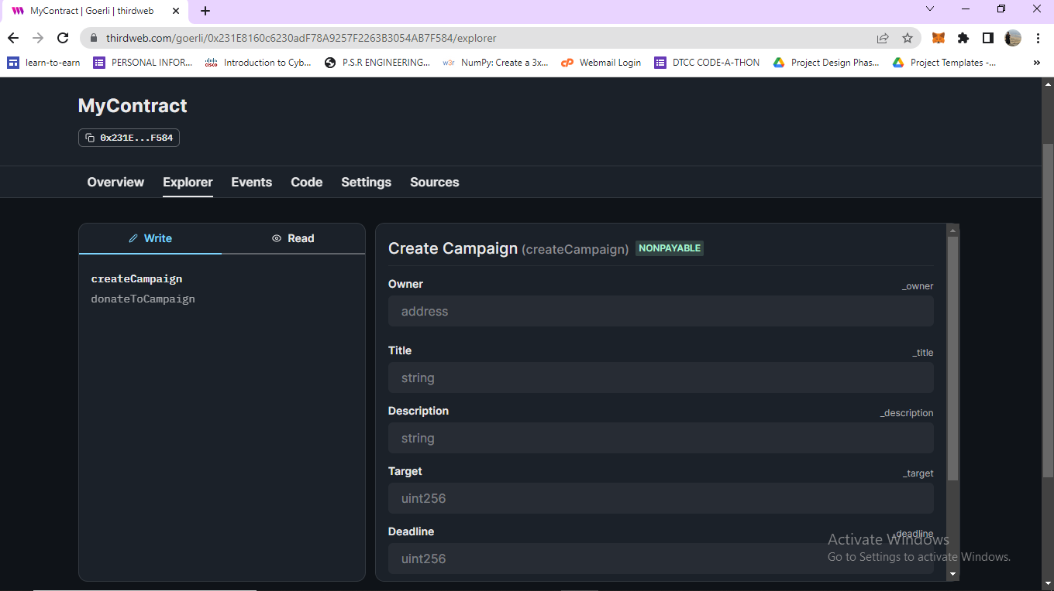
Fig 6.12 Campaign Smart Contract with different functions

Slide 29
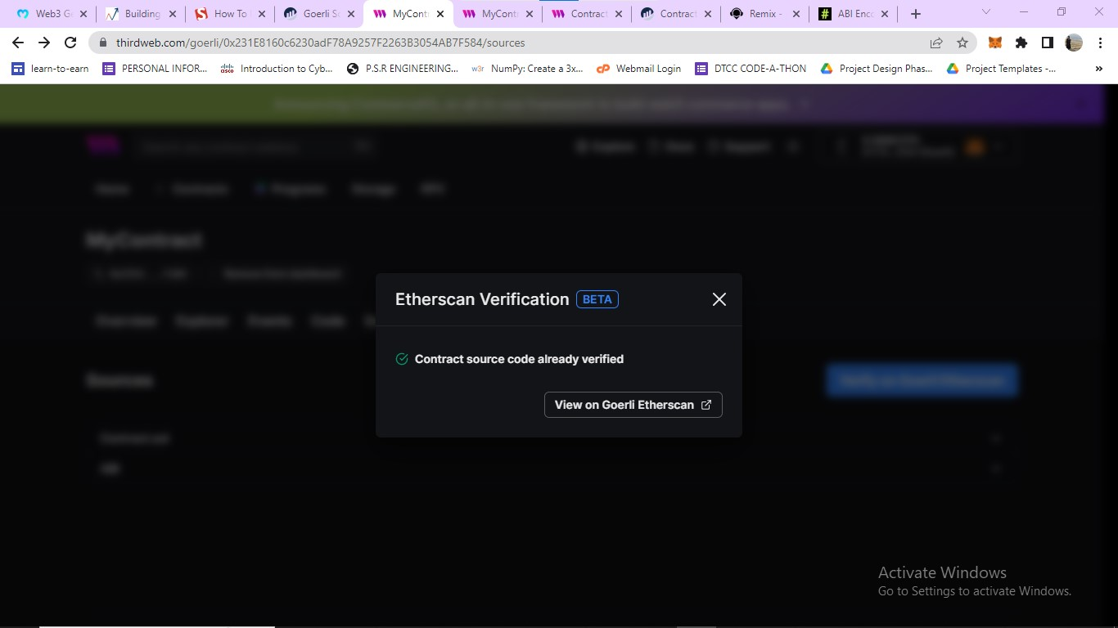
Fig 6.13 Verifying contract using Goreli Etherscan

Slide 30
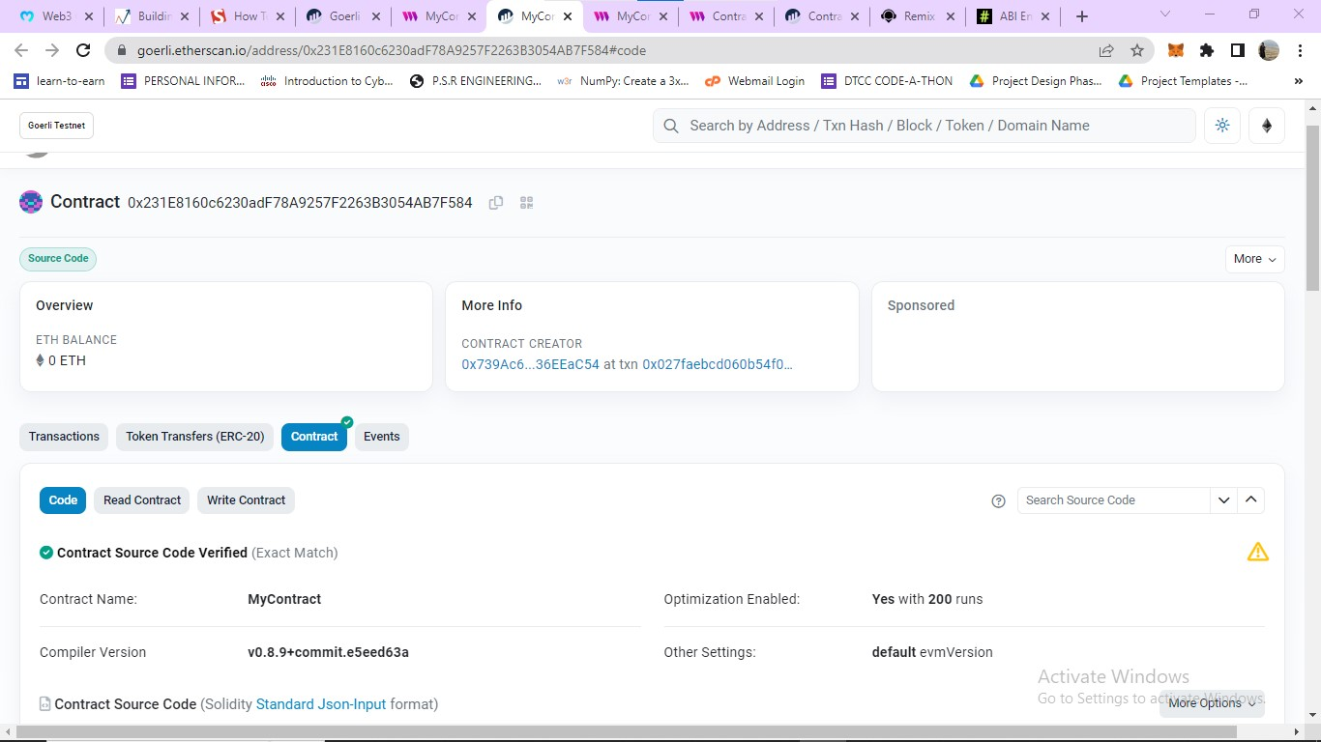
Fig 6.14 Viewing verified contract on Goreli Etherscan

Slide 31
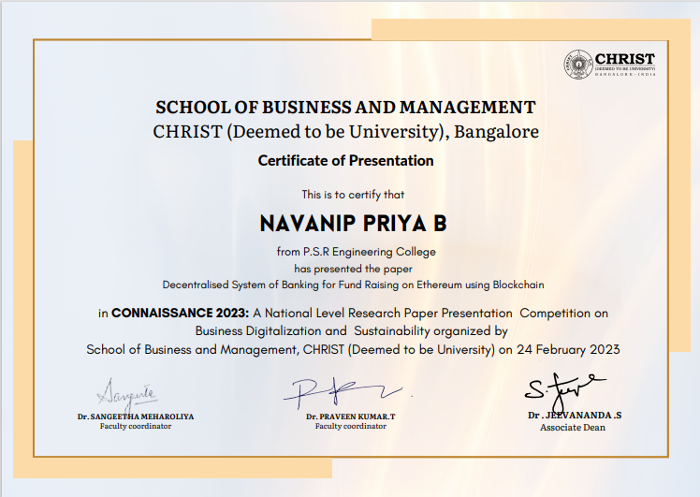

Slide 32
APPENDIX
//SPDX-License-Identifier: UNLICENSED
pragma solidity >=0.5.0 < 0.9.0;
contract CrowdFunding{
mapping(address=>uint) public contributors; //contributors[msg.sender]=100
address public manager;
uint public minimumContribution;
uint public deadline;
uint public target;
uint public raisedAmount;
uint public noOfContributors;
struct Request{
string description;
address payable recipient;
uint value;
bool completed;
uint noOfVoters;
mapping(address=>bool) voters;
}
mapping(uint=>Request) public requests;
uint public numRequests;

Slide 33
constructor(uint _target,uint _deadline){
target=_target;
deadline=block.timestamp+_deadline; //10sec + 3600sec (60*60)
minimumContribution=100 wei;
manager=msg.sender;
}
function sendEth() public payable{
require(block.timestamp < deadline,"Deadline has passed");
require(msg.value >=minimumContribution,"Minimum Contribution is not met");
if(contributors[msg.sender]==0){
noOfContributors++;
}
contributors[msg.sender]+=msg.value;
raisedAmount+=msg.value;
}
function getContractBalance() public view returns(uint){
return address(this).balance;
}

Slide 34
function refund() public{
require(block.timestamp>deadline && raisedAmount<target,"You are not eligible for refund");
require(contributors[msg.sender]>0);
address payable user=payable(msg.sender);
user.transfer(contributors[msg.sender]);
contributors[msg.sender]=0;
}
modifier onlyManger(){
require(msg.sender==manager,"Only manager can calll this function");
_;
}
function createRequests(string memory _description,address payable _recipient,uint _value) public onlyManger{
Request storage newRequest = requests[numRequests];
numRequests++;
newRequest.description=_description;
newRequest.recipient=_recipient;
newRequest.value=_value;
newRequest.completed=false;
newRequest.noOfVoters=0;
}

Slide 35
function voteRequest(uint _requestNo) public{
require(contributors[msg.sender]>0,"YOu must be contributor");
Request storage thisRequest=requests[_requestNo];
require(thisRequest.voters[msg.sender]==false,"You have already voted");
thisRequest.voters[msg.sender]=true;
thisRequest.noOfVoters++;
}
function makePayment(uint _requestNo) public onlyManger{
require(raisedAmount>=target);
Request storage thisRequest=requests[_requestNo];
require(thisRequest.completed==false,"The request has been completed");
require(thisRequest.noOfVoters > noOfContributors/2,"Majority does not support");
thisRequest.recipient.transfer(thisRequest.value);
thisRequest.completed=true;
}
}

Slide 36
REFERENCE
[1] Sakho, S., Jianbiao, Z., Essaf, F., & Badiss, Improving banking transactions using blockchain technology. In 2019 IEEE 5th International conference on Computer and Communications (ICCC) IEEE (2019).
[2] Arantes, G. M., D'Almeida, J. N., Onodera, M. T., Moreno, S. M. D. B. M., & Almeida,V. D. R. S. (2018, July). Improving the process of lending, monitoring and evaluating through Blockchain Technologies: An application of Blockchain in the Brazilian Development Bank (BNDES). In 2018 IEEE International Conference on Internet of Things (iThings) and IEEE Green Computing and Communications (Green Com) and IEEE Cyber, Physical and Social Computing (CPS Com) and IEEE Smart Data (Smart Data) IEEE (2018).
[3] Z. Zhong, SilkViser "A visual explorer of blockchain-based cryptocurrency transaction data" 2020 IEEE Conference on Visual Analytics Science and Technology (VAST) IEEE (2020).
[4] T.-S. Kang, M.-I. Joo, B.-S. Kim, T.-G. Lee “Blockchain-based lightweight transaction process modeling and development” 2021 23rd International Conference on Advanced Communication Technology (ICACT), IEEE (2021).
[5] P. Deshmukh, S. Kalwaghe, A. Appa, A. Pawar “Decentralised freelancing using ethereum blockchain” 2020 International Conference on Communication and Signal Processing (ICCSP), IEEE (2020).

